Slide 1


RESPONSIVE GROCERY WEBSITE
FRESH AND ORGANIC PRODUCTS
PRESENTED BY:
SUPRAVA SATAPATHY
UID-21MCA2805
(MASTER OF COMPUTER APPLICATION)
UNIVERSITY INSTITUTE OF COMPUTING
UNDER SUPERVISION OF:
MD.ASHIF RAJA
(ASSISTANT PROFESSOR)
UNIVERSITY INSTITUTE OF COMPUTING
DISCOVER . LEARN . EMPOWER

Slide 2

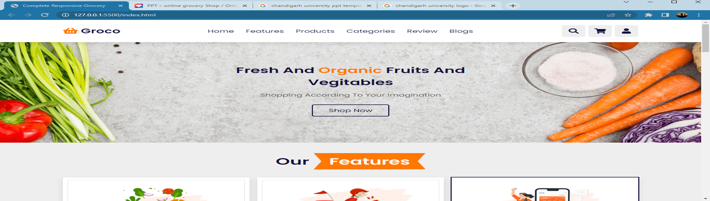
Grocery Shop India
With the availability of online grocery items , life has become easier with one less reason to worry about. Especially women who have both job and household work to manage got a boon in disguise.
*
*
3

Slide 3
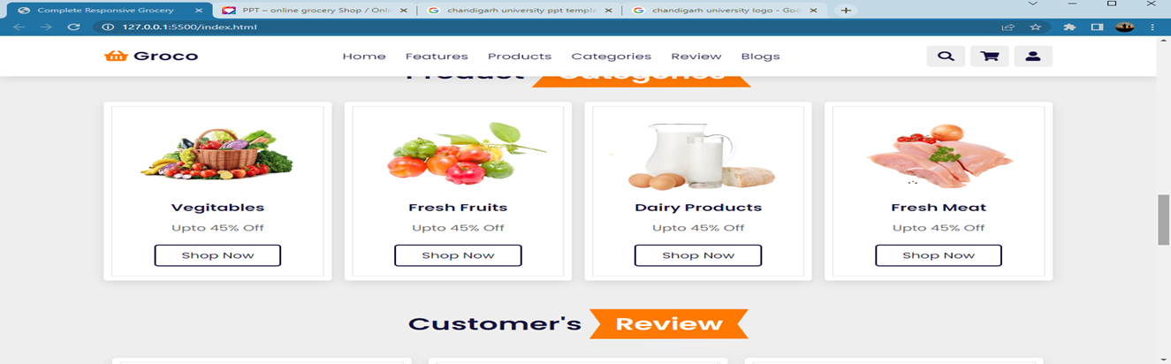
Customers Services
Usual customers:
Busy young professionals
Value saving 50mins trip and queue
Physically unfit(e.g. : seniors, pregnant, mothers,injured people etc.)
Usual products:
Dry/frozen food and housekeeping products
*
*
3

Slide 4
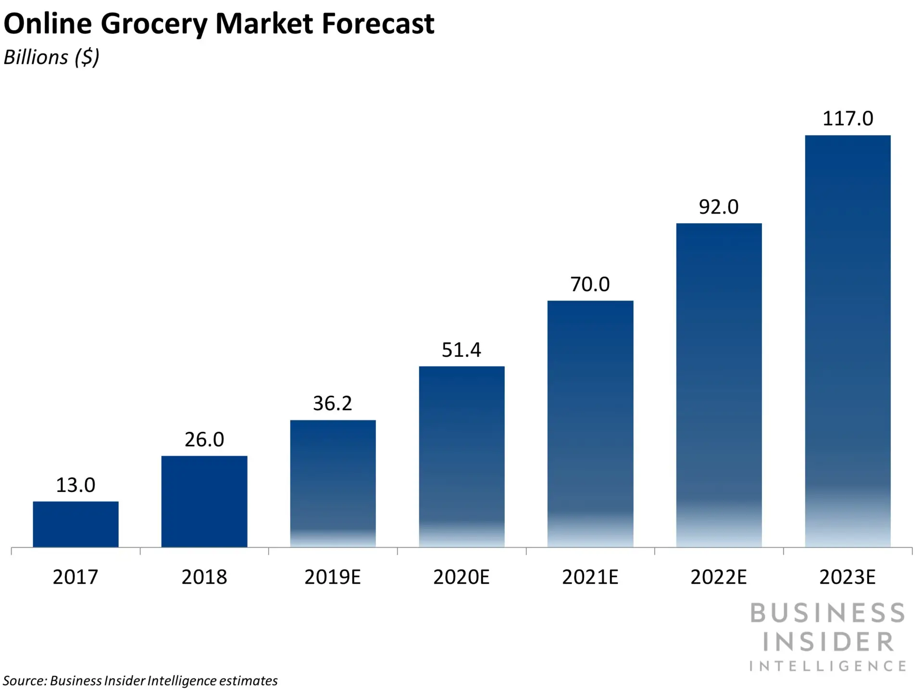
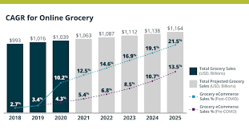
Customers Highly demands
Low service fee
Personalized/online-only offers
New products requests
Small delivery slots
Clear food quality/refund policies
Good website(stable,easy search,fast checkout)
Good customer services.
*
*
3

Slide 5
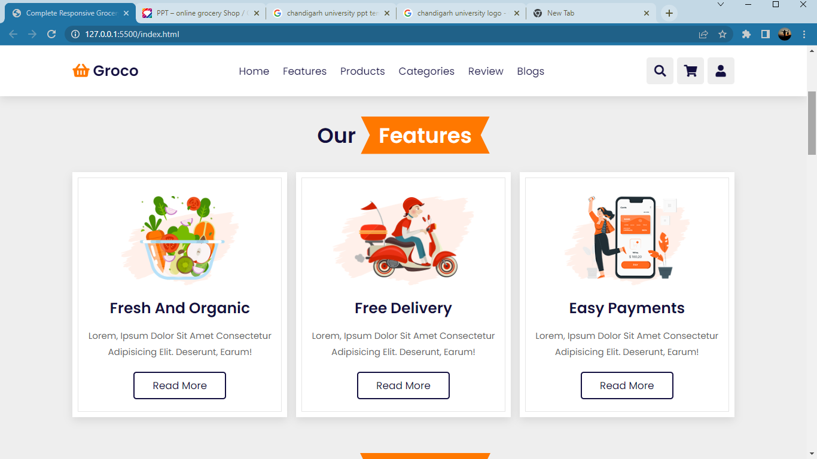
SERVICES
*
*
3

Slide 6
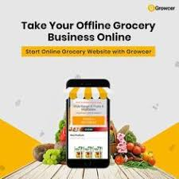
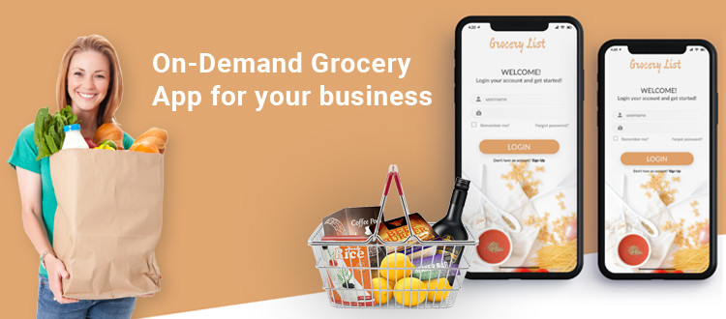
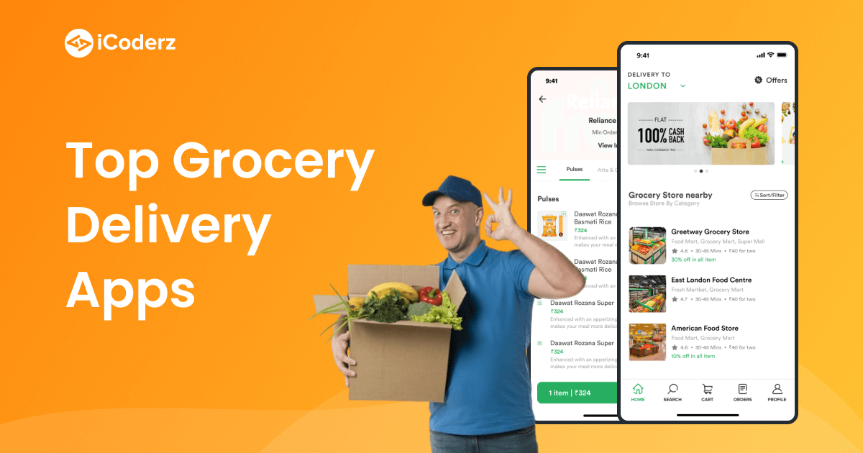
In today's busy world, time is a real constraint. Hectic work schedule hardly leaves any leisure time for the working class. There is one thing however, whose invention proved to be of great help to the mankind. The thing that is being talked about here is the Internet. It is the best place to get most jobs done, for which otherwise you had to manage more personal time than you could. Internet helps people to pay bills, buy necessary items, and find entertainment in the form of music and movies and many more things. To add to the list of items that can be bought online are groceries. The idea of Online Grocery Shop ODISHA is extremely innovative and useful as well.
*
*
3

Slide 7
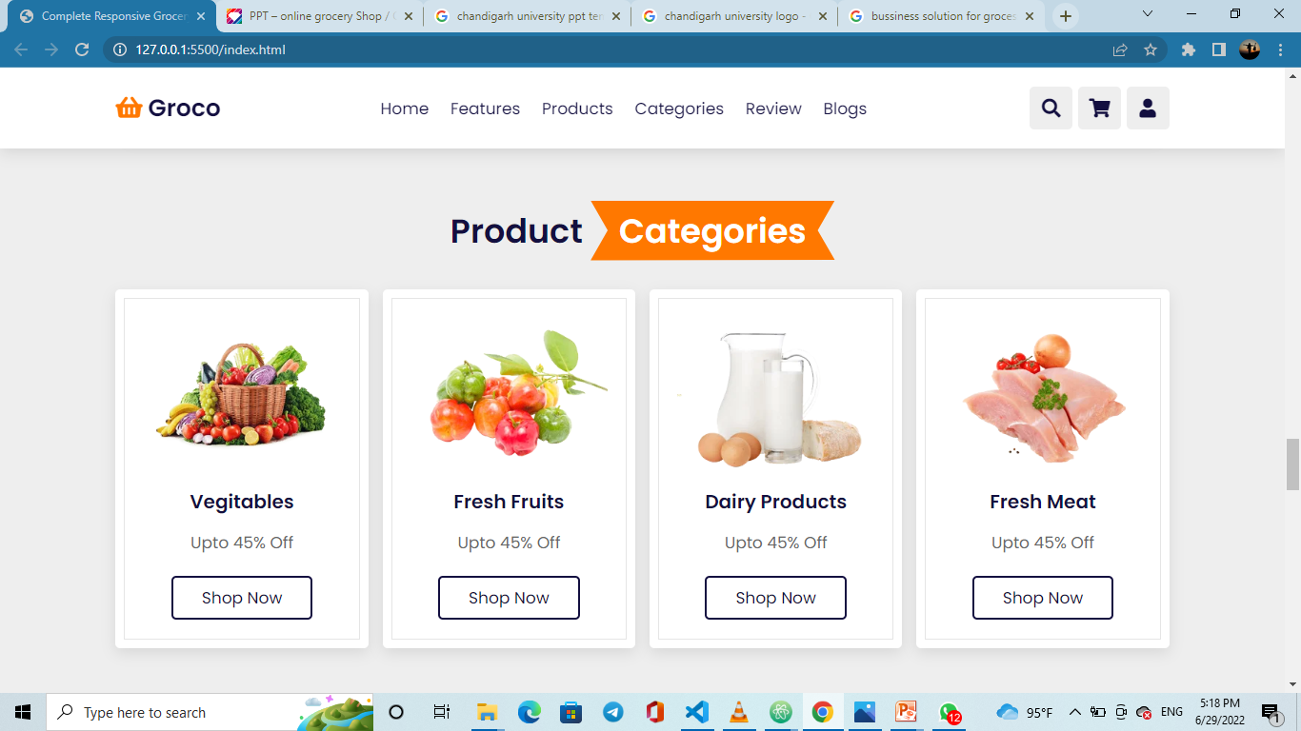
PRODUCT
You also have more options of a particular, Product as far as brands ar concerned. Thus, you can choose and experiment with different brands every time you shop online. Since, online stores have a reputation to maintain, you would find the Online Grocery items to be of highest quality. Fresh fruits, vegetables and leafy greens are also available here. You can literally find anything under one roof as far as grocery products are concerned.
*
*
3

Slide 8
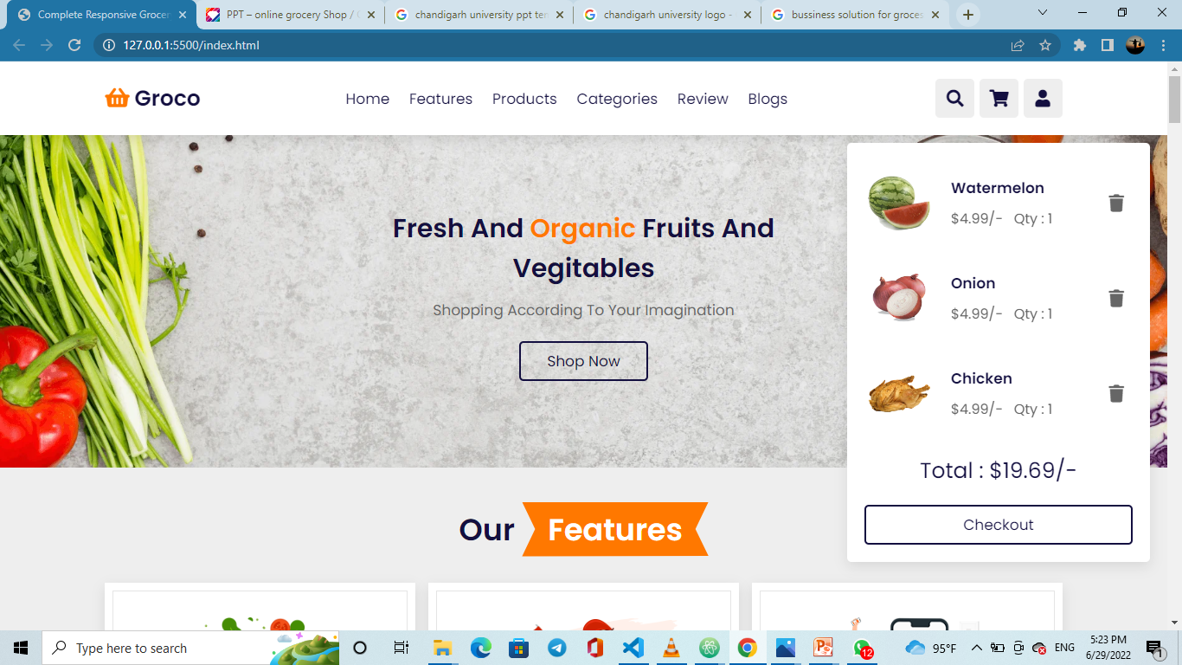
Order and online payment method
It is also very easy to place the order online. You simply need to add the products that you require in desired quantities in the cart. Once your order is complete, confirm the same and provide your shipping address. The payment method is also quite simple. You can make online payment or can ask for cash on delivery as well. The delivery of the products would be done quite quickly since the Grocery Shopping Store know your urgency.
*
*
3

Slide 9
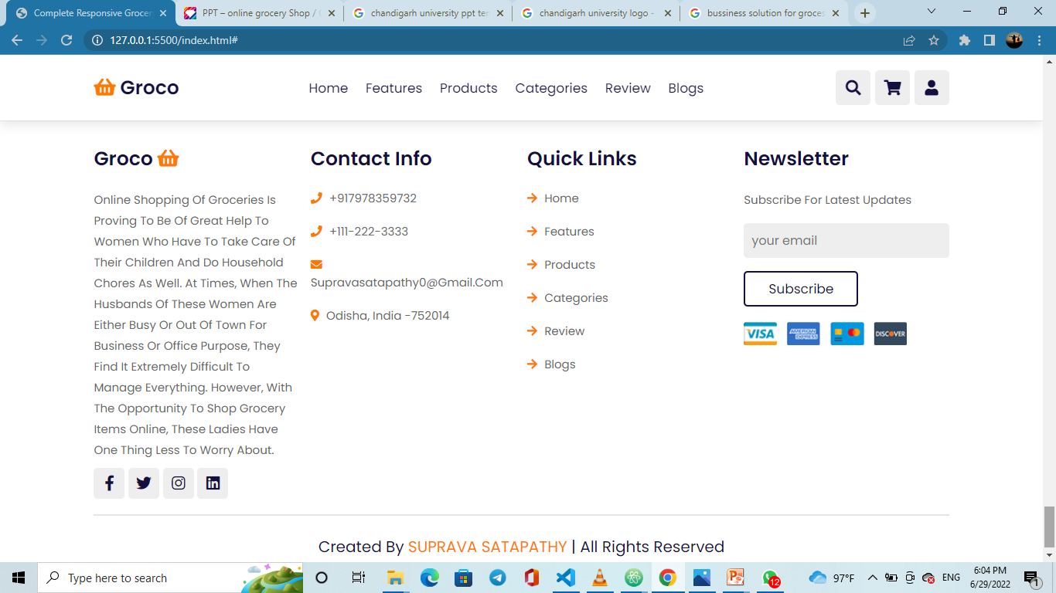
FOR YOUR HELPING
Online shopping of groceries is proving to be of great help to women who have to take care of their children and do household chores as well. At times, when the husbands of these women are either busy or out of town for business or office purpose, they find it extremely difficult to manage everything. However, with the opportunity to shop grocery items online, these ladies have one thing less to worry about.
*
*
3

Slide 10
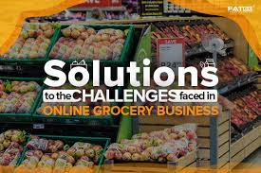
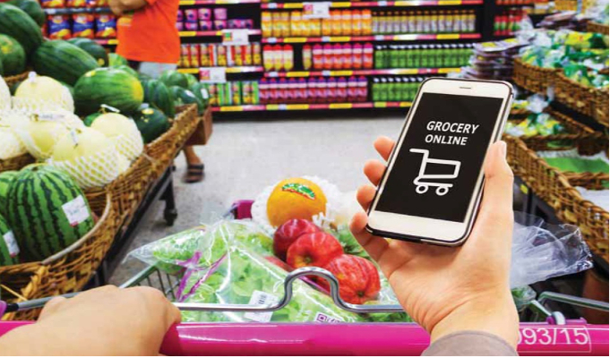
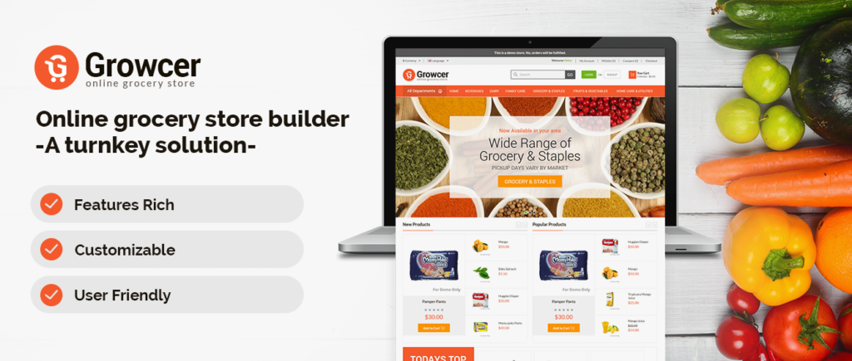
Business Solution
Online grocery shopping spare you the time of going to your local store and wait for your turn to place the order. Moreover, you get exotic and Online items in an Grocery Shop that you would not get in your locality unless you visit a mall, which may very well be in a distant area. The best part of shopping online is that you get free home delivery, which your local shop owner would not offer.
*
*
3

Slide 11
CONTACT US
*
*
3

Slide 12

*
*
3

Slide 13

THANK YOU

